Slide 1

Accelerating Deep Neural Networks with FPGAs
Author: Supervisor: Stylianos Mikeos Dr. Theocharis Theocharides

Slide 2
Agenda
Motivation & thesis goals: why accelerate CNN inference, why FPGAs
Why fpgaConvNet: where it fits vs other approaches
End-to-end workflow: PyTorch → ONNX → fpgaConvNet → Vivado → FPGA
Evaluation: ZedBoard measurements + KCU105 design-space exploration
Key takeaways: challenges, lessons learned, future work
2

Slide 3
Section A:
Project Introduction
3

Slide 4
What is the
problem
we are solving?
CNN inference is heavy (many operations + memory movement)
We want a pipeline that can:
  Deploy models fast
  Consume as low power as possible
  Measure latency/throughput
  Validate correctness vs software reference
FPGAs can help our goal as they consume relatively low power and offer low latency at the same time
4

Slide 5
Why FPGAs
vs
CPU / GPU / ASIC?
CPUs: Easiest + flexible, but often too slow for CNNs
GPUs: Great throughput, but often higher power + not ideal for small embedded platforms
Application-Specific Integrated Circuits(ASICs): Best efficiency, but fixed hardware + expensive + long development time
FPGA (our choice): “middle ground”
  Custom parallel pipeline (low latency + high throughput)
  Strong performance-per-watt (approx. 2× better than a GPU)
  Reconfigurable (update hardware for new models)
5

Slide 6
What is an
FPGA?
What is an FPGA?:
A Field Programmable Gate Array is a reconfigurable chip made of programmable logic blocks and interconnects, so we can implement custom digital hardware at low power and high speeds after manufacturing.
6

Slide 7
Thesis goals
-
What we aimed
to deliver
Build a full ONNX-to-FPGA pipeline
Run and validate on real hardware
Measure:
  latency (per inference)
  throughput (inferences/sec)
Study feasibility + scaling trends across different CNN families
7

Slide 8
The Approaches
-
How can
we do this?
Manual RTL (VHDL/Verilog)
  Max control / potentially best efficiency
  But Very time-consuming, hard to scale to many CNNs
HLS (Vivado/Vitis HLS)
  Faster development than RTL, C/C++ design
  But Still requires heavy manual optimization + integration effort
Vendor DPU stacks (e.g., Vitis AI)
  Strong performance when supported
  But Platform/toolchain constraints; not a good fit for ZedBoard-style targets
fpgaConvNet (used in this thesis)
  CNN-focused mapping + Design Space Exploration (latency/throughput/resources)
  Supports partitioning to fit large models + multi-board targeting
8

Slide 9
Why
fpgaConvNet?
We need a tool that helps with many CNNs, not just one demo
fpgaConvNet gives:
  CNN-focused mapping (dataflow mindset)
  Design Space Exploration (latency/throughput/resources)
  Partitioning to fit bigger models
  Multi-board targeting via platform files
Best fit for our thesis goal: Repeatable evaluation pipeline
9

Slide 10
Section B: fpgaConvNet Workflow Overview
10

Slide 11
Workflow
Overview
PyTorch model → ONNX export
fpgaConvNet notebook:
  Parse ONNX
  Optimize + partition if needed
  Generate HLS design
Vivado:
  Integrate design
  Build bitstream
Host/Python:
  Run on FPGA
  Compare outputs vs reference
11

Slide 12
Stage 0:
Are FPGAs the
right path
for us?
FPGA acceleration is powerful, but has some big risks
Main issues:
  Long build times (synthesis/implementation)
  Harder to debug issues and specialized staff is needed
  Board-specific integration is challenging as each platform differs
  Information online is very limited
  High-end FPGA boards can cost several thousand dollars
So we only continue if:
  Power budget matters
  We need low/consistent latency
  Or the project itself demands it
12

Slide 13
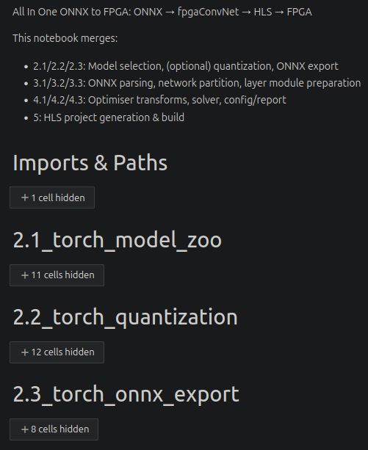
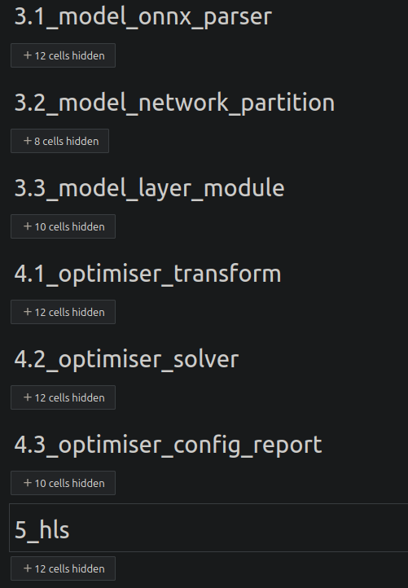
Stage 1.1: The “All-in-One” notebook pipeline
One notebook merges the whole flow:
  Model selection / optional quantization
  Parsing + partitioning
  Optimizer + solver + reports
  HLS generation
Goal: repeatable runs from model → hardware
13

Slide 14
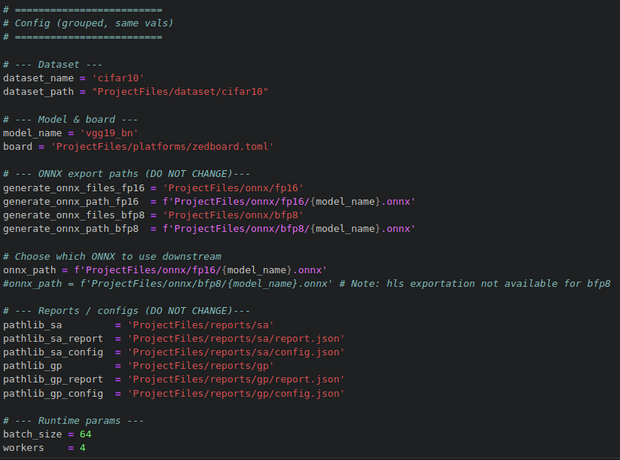
Stage 1.2: What we change per run (configuration)
Config controls each experiment:
  Dataset + model name
  Target board platform file
  ONNX path / precision version
  Batch size / workers
Output of each run:
  reports + configs
  generated artifacts for next steps
14
Notes:
Workers: how many CPU processes/threads load and preprocess data in parallel
FP16 and BFP8 are two different number formats (precisions) used to represent weights/activations during inference.

Slide 15
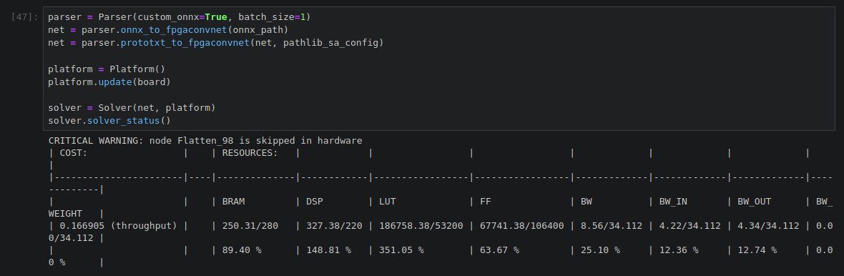
Stage 1.3: Estimated Resource Utilization (fpgaConvNet Solver)
After selecting model + board + batch size, fpgaConvNet runs the Solver; The Solver estimates if the design can fit on the target FPGA:
  BRAM / DSP / LUT / FF utilization (%); bandwidth indicators (BW in/out)
Helps us decide early: feasible vs infeasible; whether we need partitioning or different settings
Note: Warnings like ‘layer skipped in hardware’ indicate an op was not mapped to FPGA logic, so if needed we can make adjustments
15

Slide 16
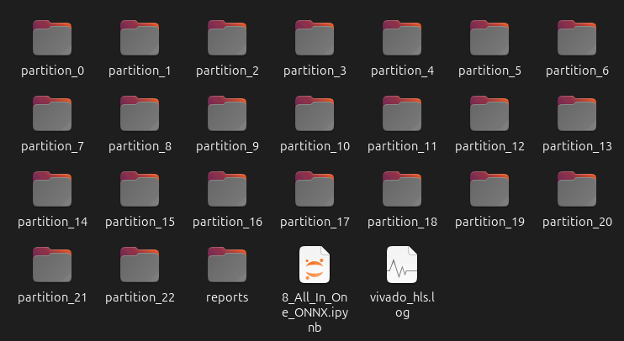
Stage 2: HLS generation & partitions
fpgaConvNet generates HLS projects
If a model is large → split into partitions
Example shown: VGG19_BN produces many partitions
Why it matters:
  helps fit resources
  more partitions → more overhead/integration effort
16

Slide 17
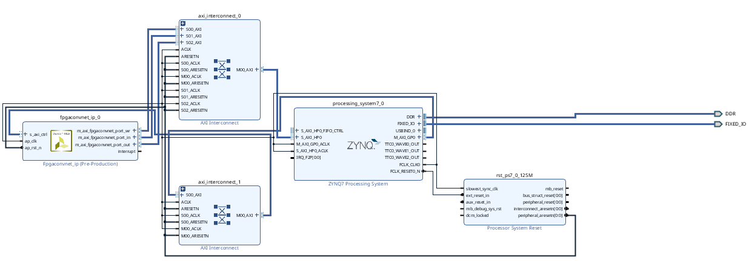
Stage 3.1: Vivado integration (ZedBoard)
Integrate accelerator IP into the board system
This is where the design becomes a real FPGA system
17

Slide 18
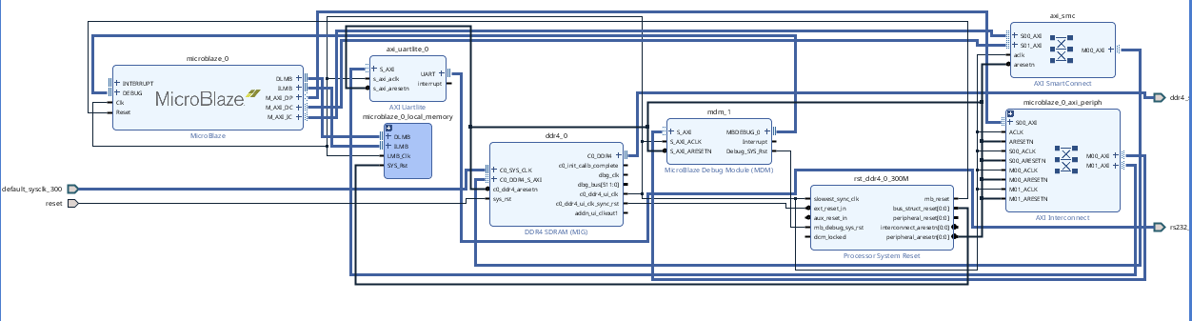
Stage 3.1: Different board → different block design (KCU105)
Each board has different infrastructure/components
So the system design changes significantly per platform
This is why multi-board deployment is not exactly “plug & play”
18

Slide 19
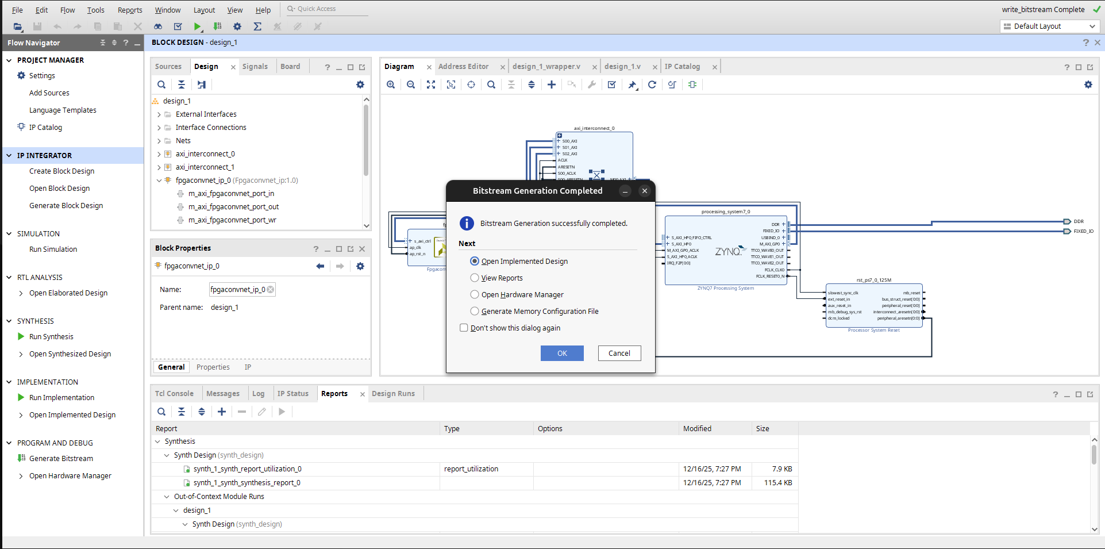
Stage 3.2: Export hardware (bitstream)
Vivado builds the final hardware image
Output: bitstream (.bit); Afterwards, we export the project as hardware (.xsa)
This is the “hardware artifact” that programs the FPGA
19

Slide 20
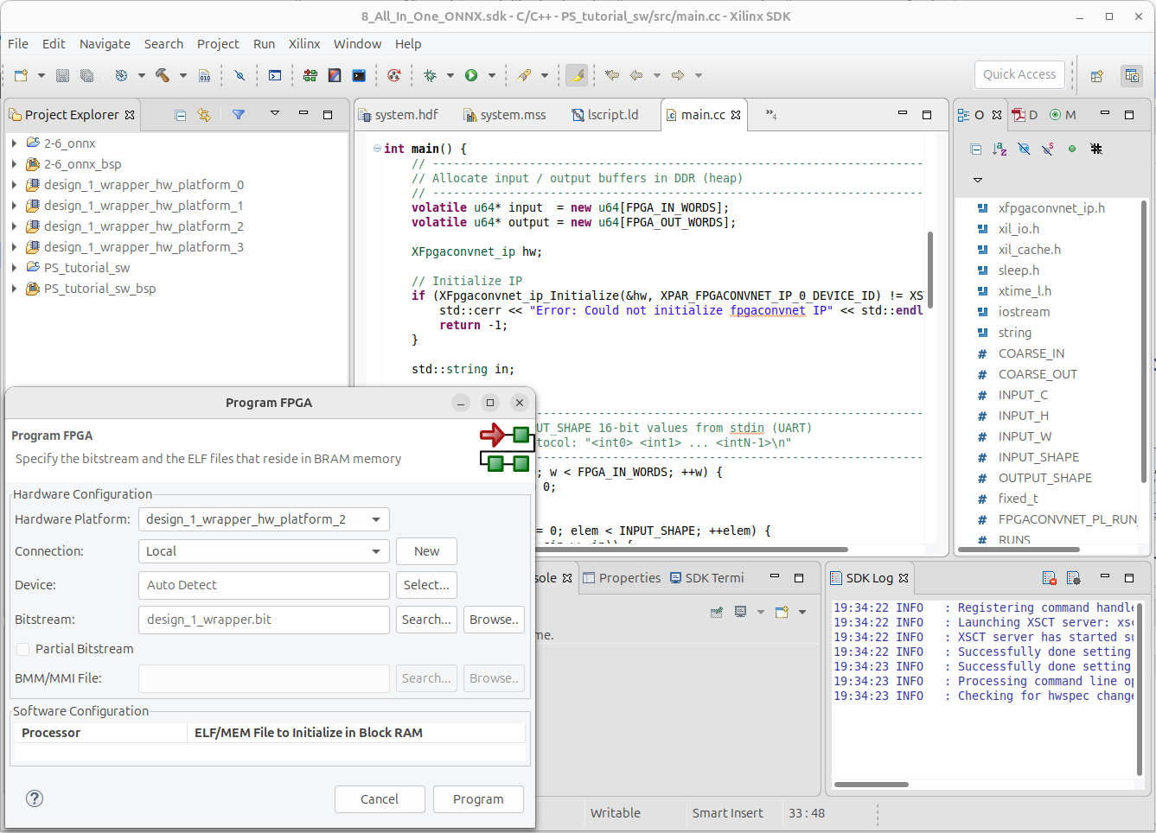
Stage 4: Load software on board using Vivado SDK (C/C++)
Load the C/C++ control program to the board
Responsibilities:
  Allocate buffers
  Configure accelerator
  Start runs
  Read results
20

Slide 21
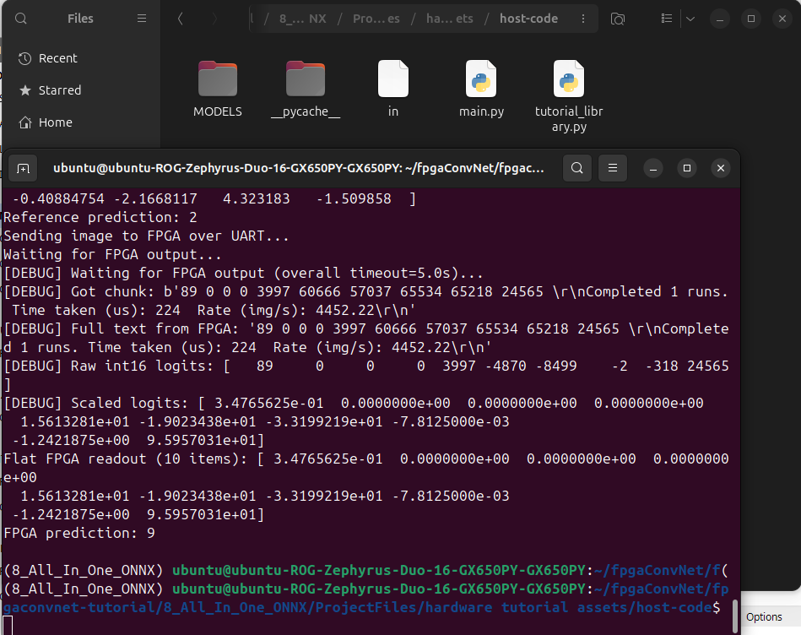
Stage 5: End-to-end validation (Python)
Python script validates the full pipeline:
  ONNX Runtime reference (CPU)
  send input to FPGA (through UART)
  read logits back (fixed-point)
  decode/scale and compare prediction/logits
21
Notes:
FPGA outputs are fixed-point integers (e.g., int16) to make hardware cheaper/faster; they represent the same information as float logits but scaled.
We decode the integer logits, scale them back to a comparable range, and validate correctness mainly by matching the predicted class (argmax), not exact float equality.

Slide 22
Section C:
Evaluation & Conclusion
22

Slide 23
Evaluation setup
–
What we
measured
ZedBoard: real runs
  Latency, throughput, correctness check
KCU105: scaling study
  Partitions + resources + estimated performance
Metrics:
  Latency (ms), throughput (inf/s)
  LUT/FF/BRAM/DSP
  Partition count
  Correctness vs reference
23

Slide 24
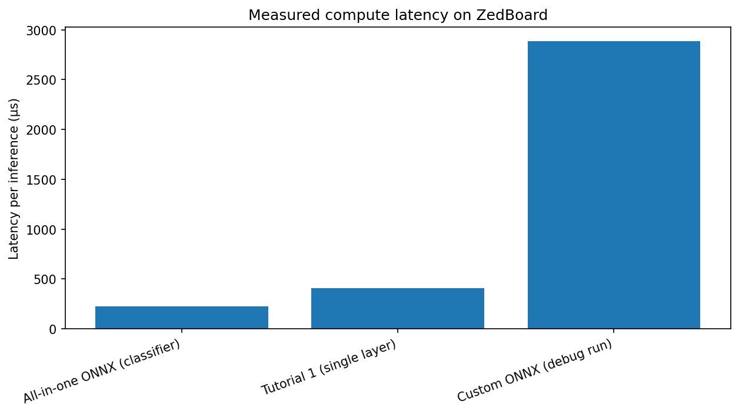
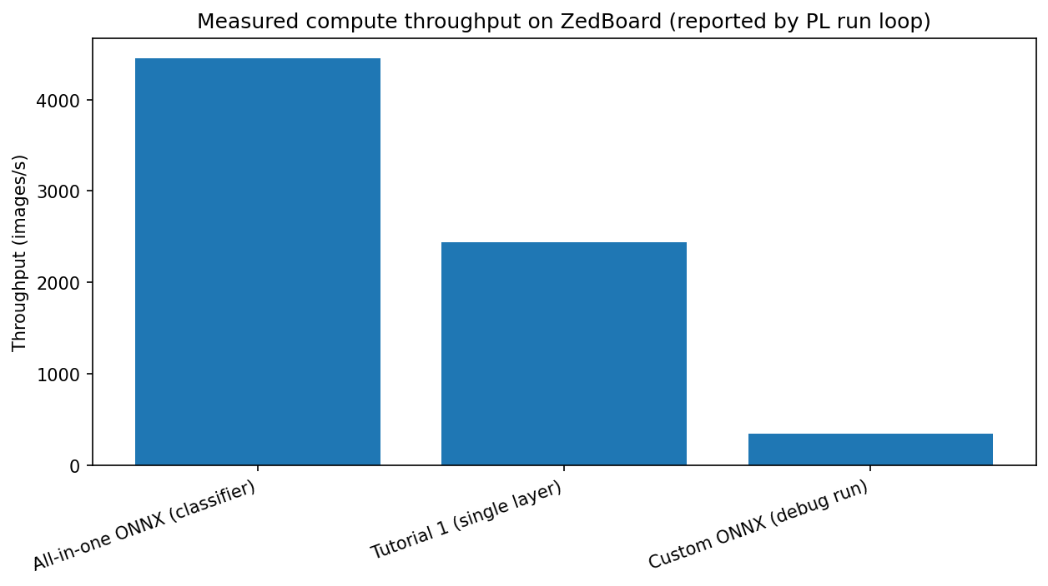
ZedBoard: Latency & Throughput
Measured on real hardware
Best configuration shows:
  Very low compute latency; High inference rate
Confirms end-to-end pipeline is functional and fast
24

Slide 25
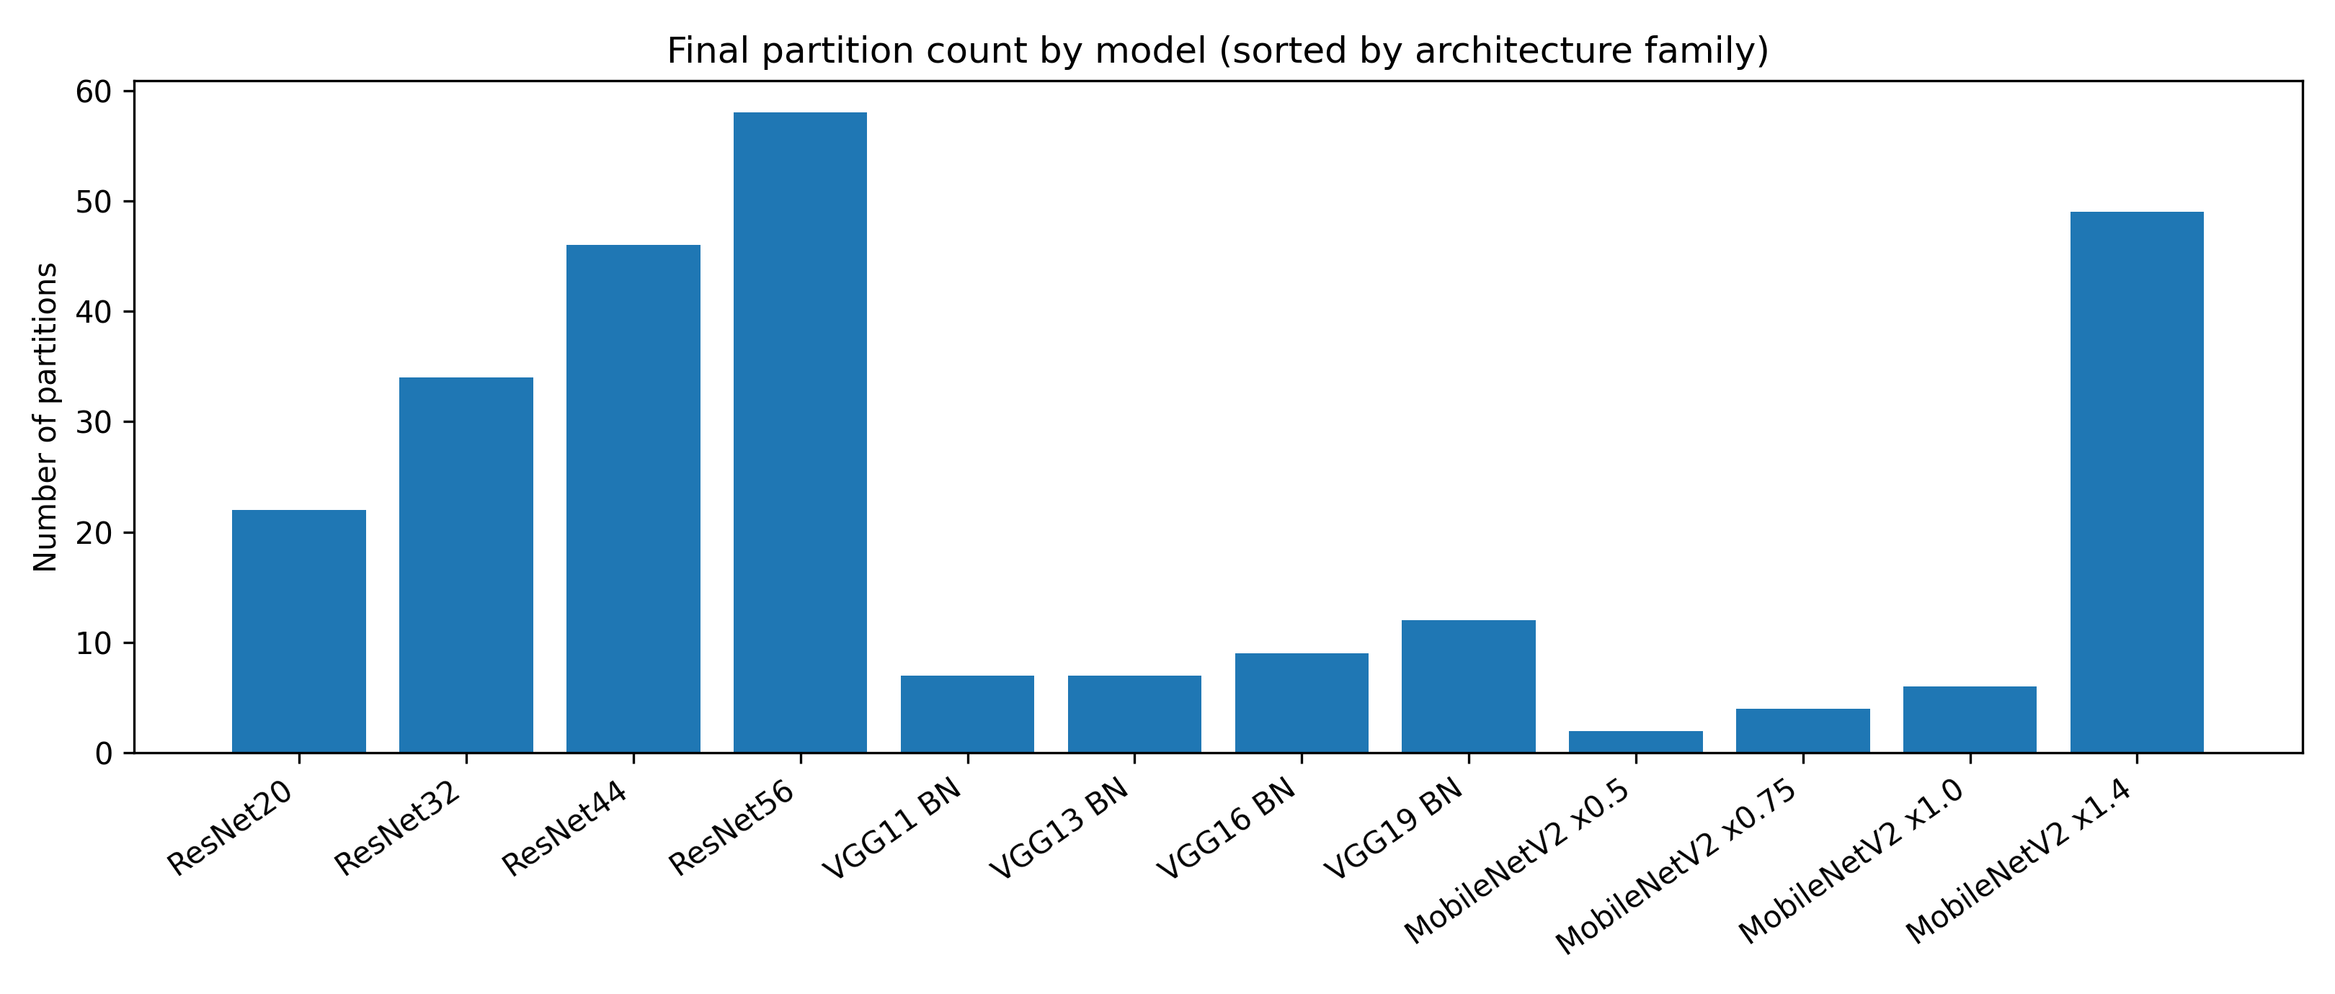
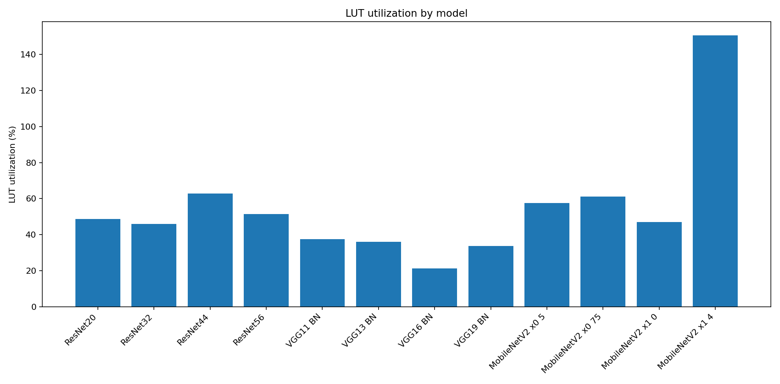
KCU105: Partitions & feasibility
Larger models → more partitions
Resources define feasibility (some configs exceed LUT usage)
Main takeaway:
  not every model scales cleanly to every FPGA target
25

Slide 26
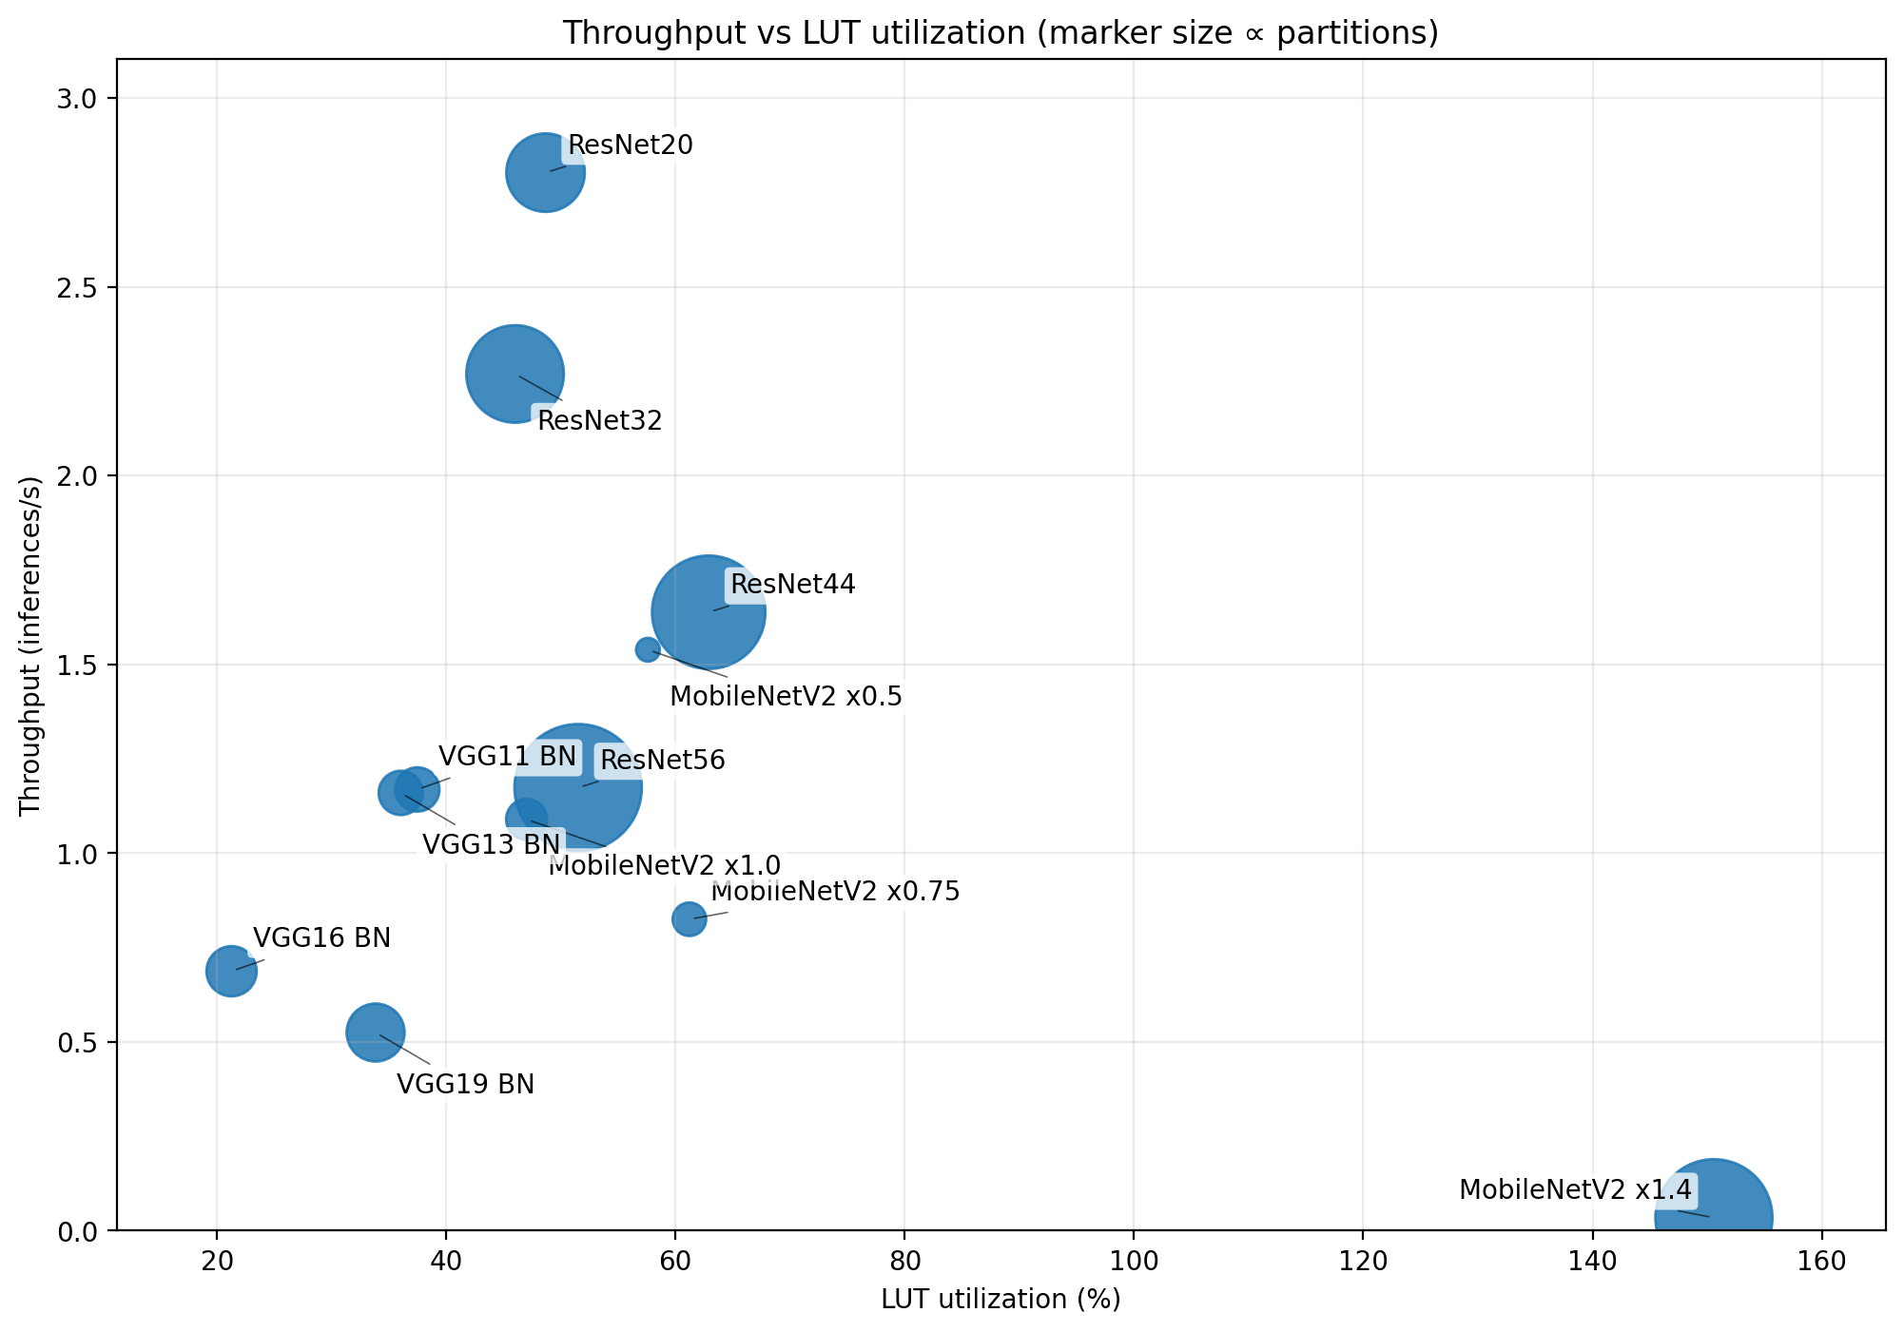
KCU105: Throughput vs LUT Utilization
This plot summarizes the efficiency trade-off across models on KCU105:
  x-axis: LUT utilization (%)
  y-axis: estimated throughput (inf/s)
  bubble size: number of partitions (bigger = more partitions)
Key observations:
  ResNet20/32 achieve high throughput with moderate LUT usage
  Deeper models generally increase LUT and/or partitions with lower throughput
  MobileNetV2 ×1.4 is an outlier: very high LUT usage with near-zero throughput (not usable)
Main takeaway:
  Best candidates are those in the top-left region (high throughput, low LUT, fewer partitions)
26

Slide 27
Conclusion
Built a complete and repeatable ONNX-to-FPGA flow: PyTorch → ONNX → fpgaConvNet → Vivado → FPGA deployment
Validated correctness by comparing FPGA outputs against a software reference
Measured real performance on ZedBoard and confirmed the end-to-end pipeline works in practice
Scaling study on KCU105 highlighted feasibility limits and the impact of resources + partitioning across CNN families
Main takeaway: fpgaConvNet is a strong toolflow for rapid exploration + practical FPGA deployment of CNN inference
27

Slide 28
Future work
Test on different datasets other than CIFAR-10/100
Try more custom ONNX models + better quantization strategies
Deploy more networks fully on-board (beyond current case study)
Explore dynamically reconfigurable hardware, where our CNN model changes mid runtime
28

Slide 29
Thank you for your attention

